Slide 1
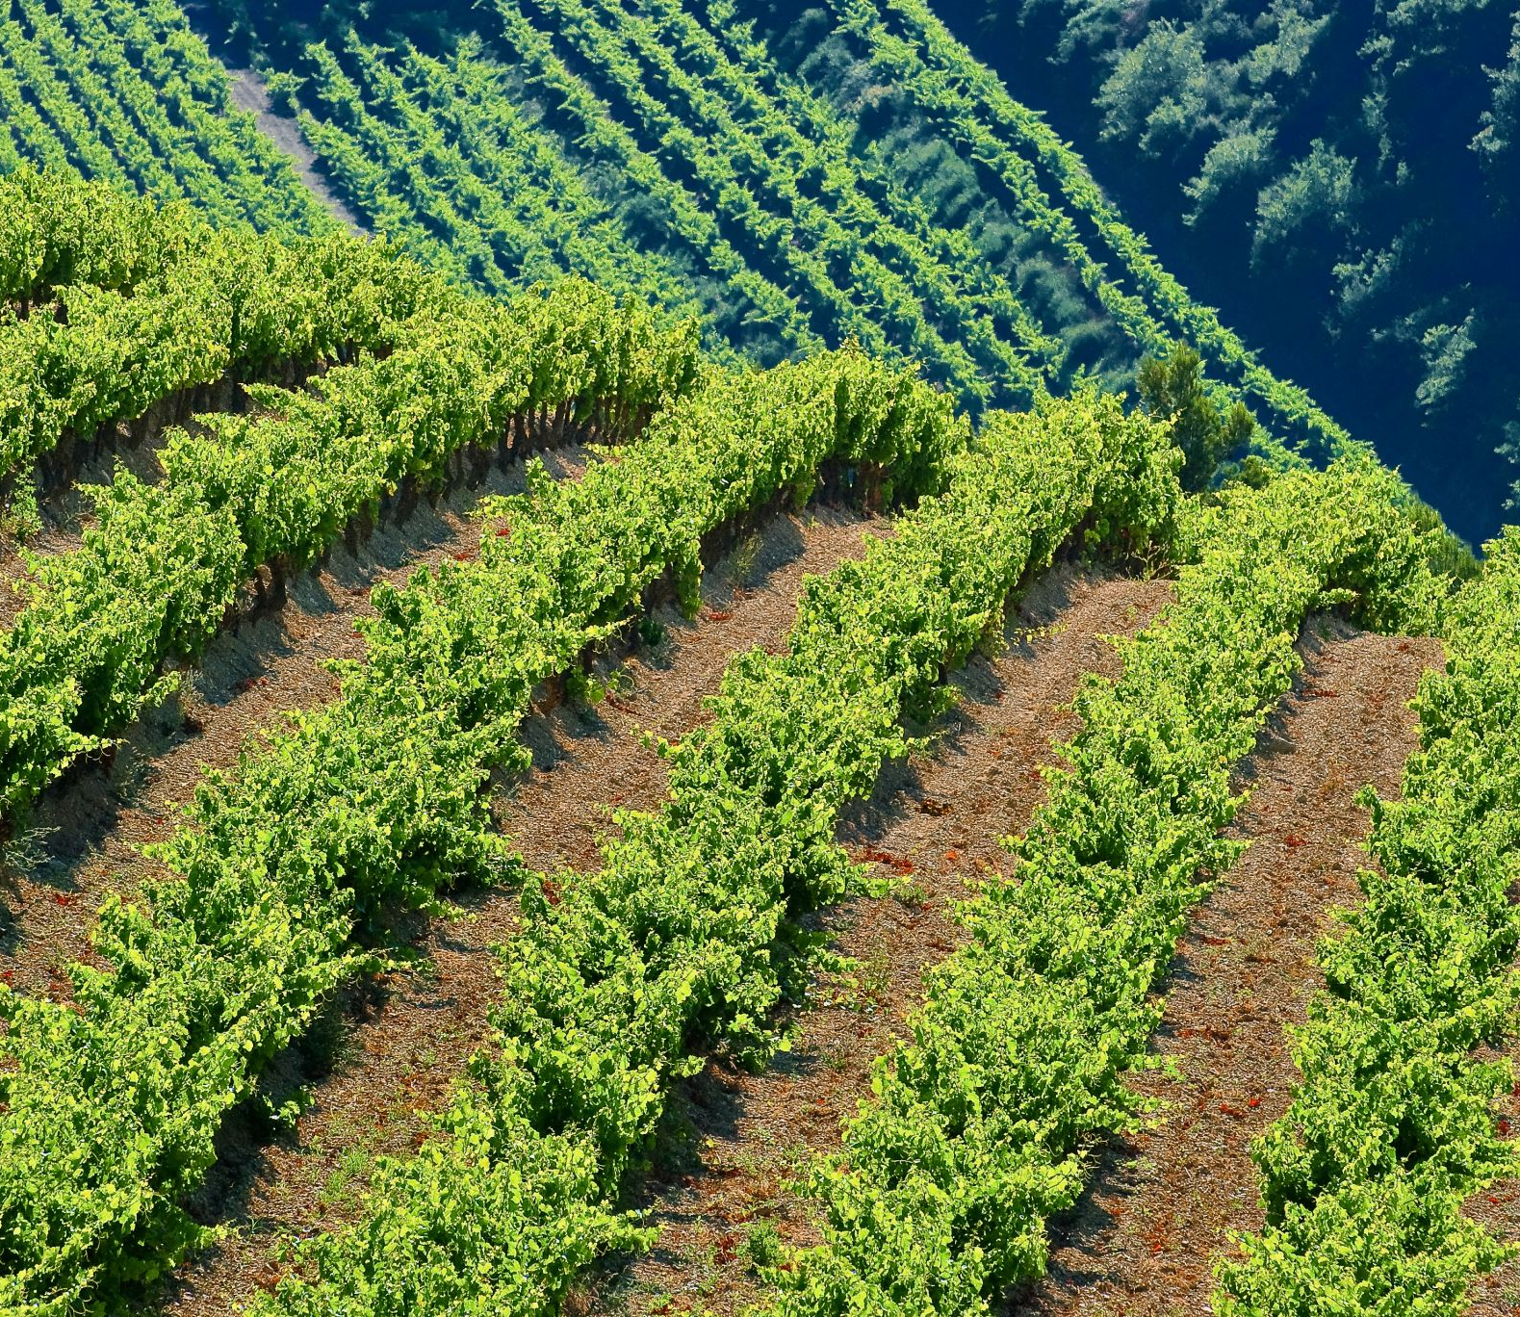
system simulation of crops grown in different Heinz's farms.

Slide 2
Prepared By:
- Mahmoud Zain Sabto 180501448. - Khalid Saud 180501244. - Mohammed Saber 170501596. - Hakan BERBER 140501024. - Rana Hummas Sarwar 180501584.

Slide 3
Methodology:
we will try and run the simulation on the crops (tomatoes, hot peppers) that are grown in Heinz farms.
while keeping into consideration the characteristics of each farm.

Slide 4
the table represents the yield of each crop, we will be running the simulation on it:
field | unripe tomatoes | ripe tomatoes | spoiled tomatoes | unripe peppers | ripe peppers | spoiled peppers
Turkey | 10% | 72% | 18% | 12% | 85% | 3%
US | 24% | 70% | 6% | 3% | 87% | 10%
Canada | 20% | 68% | 12% | 24% | 65% | 11%
South Korea | 8% | 80% | 2% | 11% | 88% | 1%

Slide 5
the simio simulation will contain a source and a server and 8 sinks for 8 different outcomes for each farm:
a sink for unripe tomatoes
the source is the truck that delivers the tomatoes
the server is the quality control machine
a sink for ripe tomatoes
a sink for spoiled tomatoes
a sink for unripe peppers
the source is the truck that delivers the tomatoes
the server is the quality control machine
a sink for ripe peppers
a sink for spoiled peppers

Slide 6
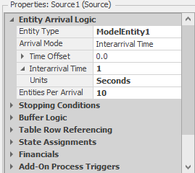
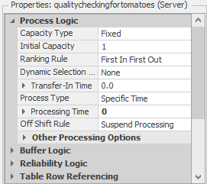
the server can process a lot of crops at the same time (10 crops per second), the way we can determine that is by setting the arrival time for 1 second and 10 entities per arrival in the source and setting the service time in the server for 0 seconds for each server and each source.

Slide 7
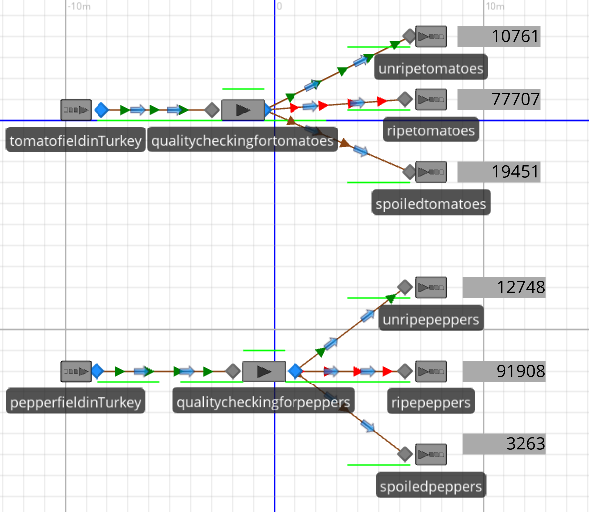
after running the simulation for 3 hours on each country, we will get these results:
Turkey: total unripe crops : 23509
total ripe crops : 169615
total spoiled crops : 22714
rank : 3

Slide 8
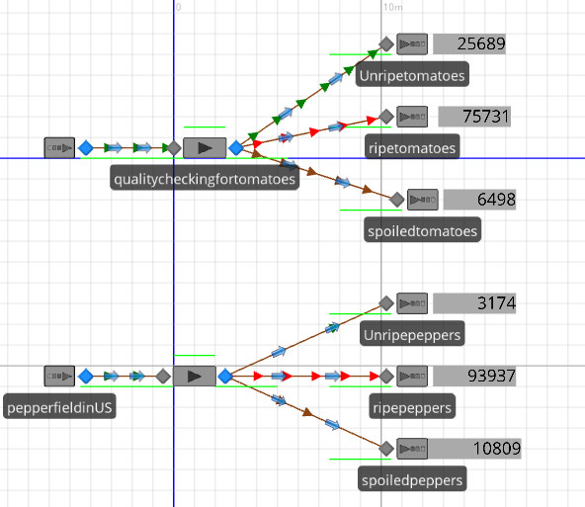
total unripe crops : 28863 total ripe crops : 169668 total spoiled crops : 17307 rank : 2
United States:

Slide 9
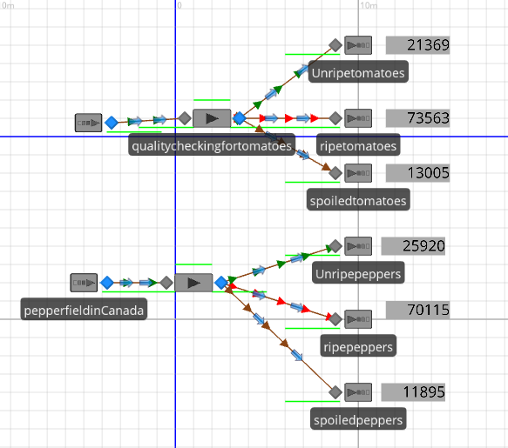
Canada:
total unripe crops : 47289
total ripe crops : 143678
total spoiled crops : 24900
rank : 4

Slide 10
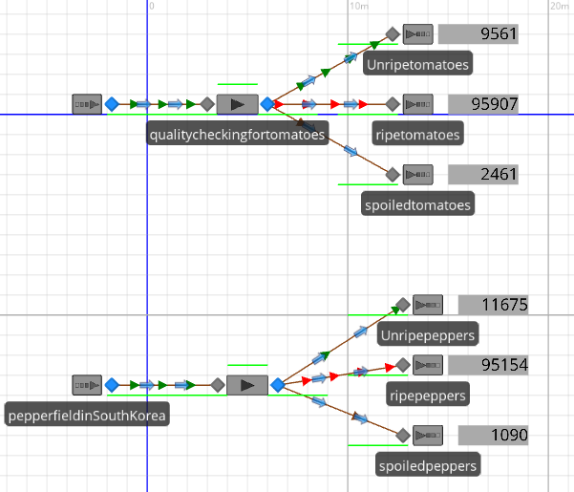
South Korea:
total unripe crops : 21236
total ripe crops : 191061
total spoiled crops : 3551
rank : 1

Slide 11
the final table of information:
field | unripe tomatoes | ripe tomatoes | spoiled tomatoes | unripe peppers | ripe peppers | spoiled peppers
Turkey | 10761 | 77707 | 19451 | 12748 | 91908 | 3263
US | 25689 | 75731 | 6498 | 3174 | 93937 | 10809
Canada | 21369 | 73563 | 13005 | 25920 | 70115 | 11895
South Korea | 9561 | 95907 | 2461 | 11675 | 95154 | 1090
In the next slide, we will discuss some questions

Slide 12

Why is it necessary to do all that?
it is always a good thing for the company's HQ to simulate what is happening on its own properties, it is also good to monitor how good is that property doing and how could the company rely on it if needed in some circumstances.

Slide 13
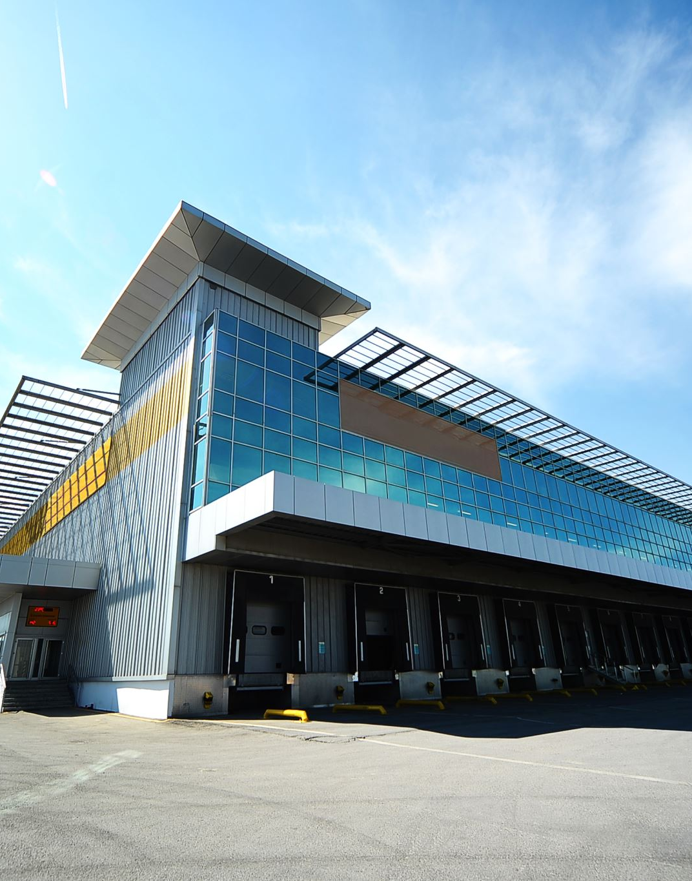
does this help the company find an optimal solution to a problem?
- yes, it would help the company if it is running short on one kind of sauce.
- for example, if the company is running short on the stock of hot sauce the company would focus its production on hot peppers.

Slide 14
why wouldn't the company "Heinz" grow all its crops in South Korea (the most efficient country)?
the company makes a lot of products other than ketchup and hot sauce.
some products are only preferred in some countries more than others.
the cost of shipping the product around the world ether as crops for manufacturing or already manufactured at South Korea.

Slide 15

can we run this simulation on any kind of crops?
- it can run to determine the yield of any kind of crop.
- it requires an experienced person who can work on SIMIO to implement the functions
- the probability that could affect the growth of crops each year.

Slide 16
what does the company do with unripe or spoiled crops?
usually, food manufacturing companies discard all of their unwanted products, it requires more work and labor hours to try and sell it or do something with it that would profit the company, but it could be given for free to nearby farmers and it can be used for livestock or for compost.

